Slide 1
AMA PERIODONTAL TEST
(bana type method)
An express, chair-side test for rapid detection of the «red complex» bacteria associated with inflammatory periodontal diseases
HEXAGON INTERNATIONAL (GB) LTD Telephone ENGLAND ( 44 ) 1442 871710 E-mail info@HexagonLimited.com

Slide 2
AMA PERIODONTAL TEST
APPLICATIONS
assisting the dental professional in establishing the presence of the 3 red complex bacteria :
B.Forsythus, T. Denticola, P. Gingivalis
which in concentration can indicate the presence of periodontal disease and, in some cases, of halitosis (when the cause is perio disease). This evidence can also be shown to the patient to explain the necessity of treatment.
HEXAGON INTERNATIONAL (GB) LTD

Slide 3
AMA PERIODONTAL TEST
APPLICATIONS
for healthcare professionals to monitor progress in a course of perio disease treatment, such as deep cleaning, root planing, or antibiotic treatment by the dentist or the hygienist .
HEXAGON INTERNATIONAL (GB) LTD

Slide 4

APPLICATIONS
for dentists practising implant work and to assess
perio infection, particularly in pre- and post-op settings.
HEXAGON INTERNATIONAL (GB) LTD

Slide 5
APPLICATIONS
For use in research and post-grad studies in this important area of dentistry research where increasingly clinical investigations appear to implicate the perio disease bacteria in wider systemic problems in the body ( such as heart disease, some cancers, pre-term births, etc. )
HEXAGON INTERNATIONAL (GB) LTD

Slide 6

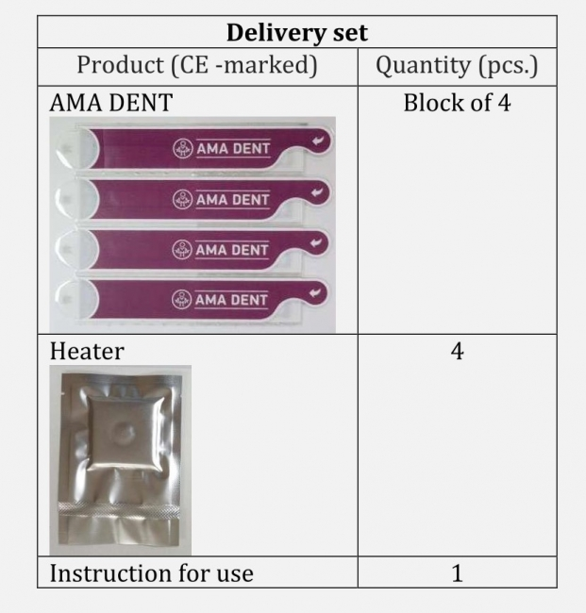
TEST KIT
HEXAGON INTERNATIONAL (GB) LTD

